Slide 1

Notes:
Core Topic: Introduction to the Horizon Kinetics Framework and Financial Exchanges as Structural Outperformers
Good morning, everyone, and welcome. Today, we are exploring one of the most powerful and enduring investment theses in global capital markets: The Architecture of Outperformance.
If you look at the subtitle on this slide, it sets our core inquiry: Why financial exchanges systematically beat the market. Insights from James Davolos and the Horizon Kinetics framework. For decades, institutional investors have chased growth stocks, cyclical commodities, and complex trading strategies, frequently underperforming the broader indices over long time horizons.
Yet, hidden in plain sight, financial exchanges—the infrastructure underlying global capitalism—have quietly and consistently compounded at rates that leave traditional indexes far behind. Drawing from the rigorous, long-horizon analysis of James Davolos and Murray Stahl at Horizon Kinetics, this presentation breaks down the structural mechanics of 'croupier businesses.' Let's examine how financial exchanges achieve this structural alpha.
20 Years of Investing in Exchanges in 1 Hour | James Davolos
https://www.youtube.com/watch?v=4Ay7d4fSflM

Slide 2
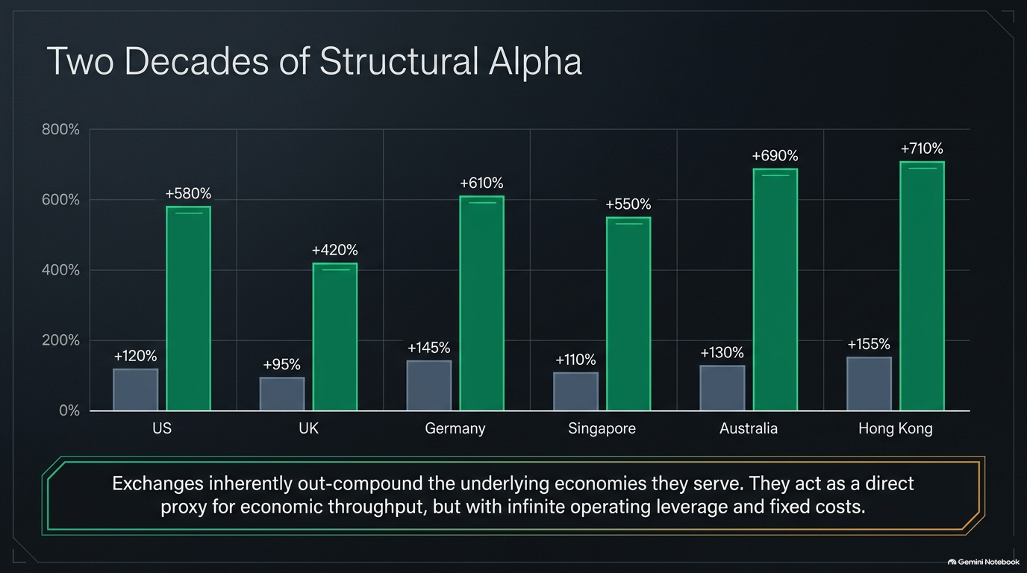
Notes:
Core Topic: Global Exchange Performance Over 20 Years Across US, UK, Germany, Singapore, Australia, and Hong Kong
Let's begin with empirical reality. Look at the 20-year performance comparison chart on this slide:
Across every major global financial center—the US, UK, Germany, Singapore, Australia, and Hong Kong—exchanges (represented by the tall green bars) have outperformed their local indices by massive multiples, generating cumulative returns ranging from +420% to over +710%, compared to baseline index gains hovering around +90% to +155%.
The Core Thesis: Exchanges inherently out-compound the underlying economies they serve. They act as a direct, unleveraged proxy for economic throughput, but with infinite operating leverage and fixed cost bases. When nominal activity rises, the exchange takes its toll without incurring proportional operational expansion.

Slide 3
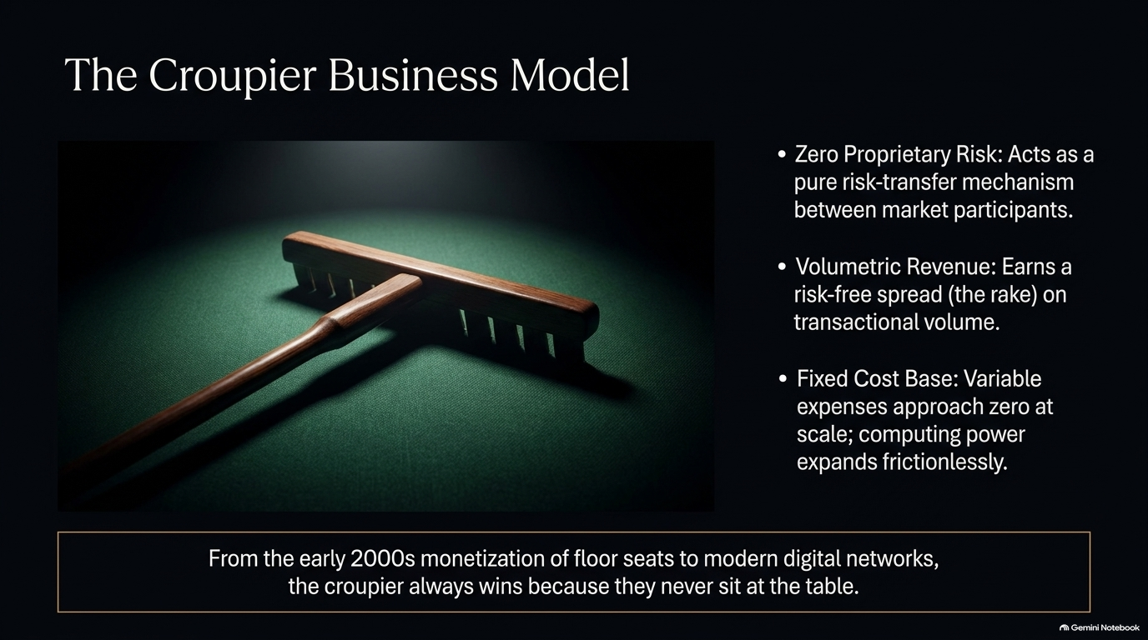
Notes:
Core Topic: Zero Proprietary Risk, Volumetric Revenue, and Fixed Cost Advantages
Why do these businesses possess such unique compounding characteristics? We call this The Croupier Business Model. Think of a casino croupier who collects a rake from every hand dealt without ever placing a bet:
Zero Proprietary Risk: Exchanges act as pure risk-transfer mechanisms between market participants, taking zero directional capital risk on their balance sheets.
Volumetric Revenue: They earn a risk-free spread—the 'rake'—on every unit of transactional volume.
Fixed Cost Base: Variable expenses approach zero at scale; once the matching engine and regulatory infrastructure are built, processing another trillion dollars of volume expands computing power frictionlessly.
From the early 2000s monetization of floor seats to modern high-frequency digital networks, the croupier always wins because they never sit at the table.

Slide 4
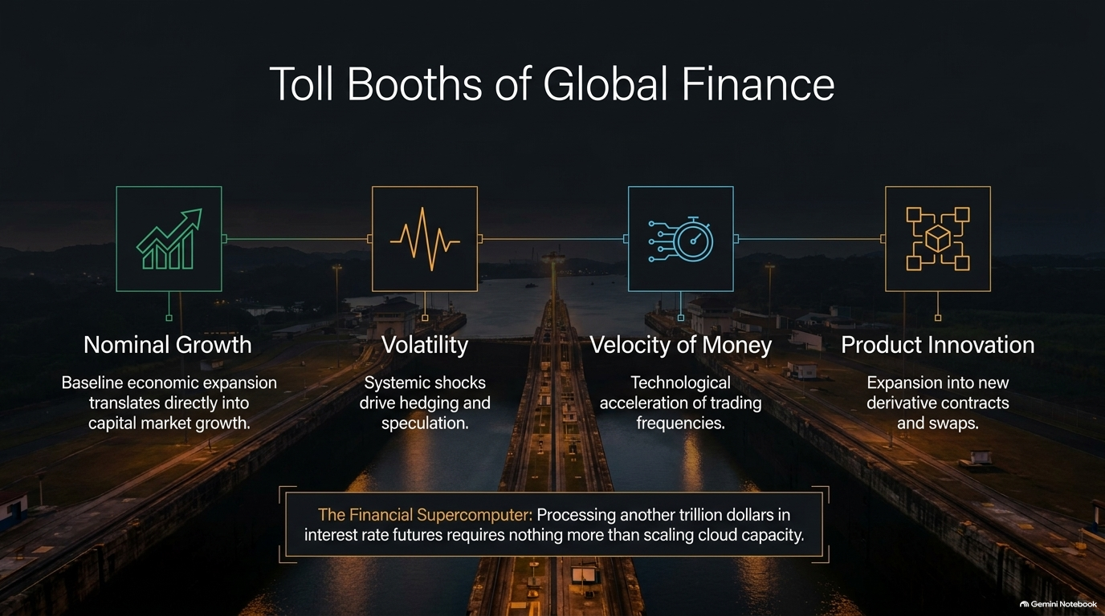
Notes:
Core Topic: Nominal Growth, Volatility, Velocity of Money, and Product Innovation
Exchanges operate as the ultimate Toll Booths of Global Finance. Look at the four foundational growth drivers illustrated on this slide:
Nominal Growth: Baseline economic expansion translates directly into capital market growth.
Volatility: Systemic shocks, geopolitical crises, and uncertainty drive hedging and heavy speculative volume.
Velocity of Money: The technological acceleration of trading frequencies and algorithmic execution increases transaction counts.
Product Innovation: Continuous expansion into new proprietary derivative contracts, interest rate swaps, and specialized indexes.
The Financial Supercomputer: Processing another trillion dollars in interest rate futures requires nothing more than scaling cloud capacity. The marginal cost of volume is practically nil.

Slide 5
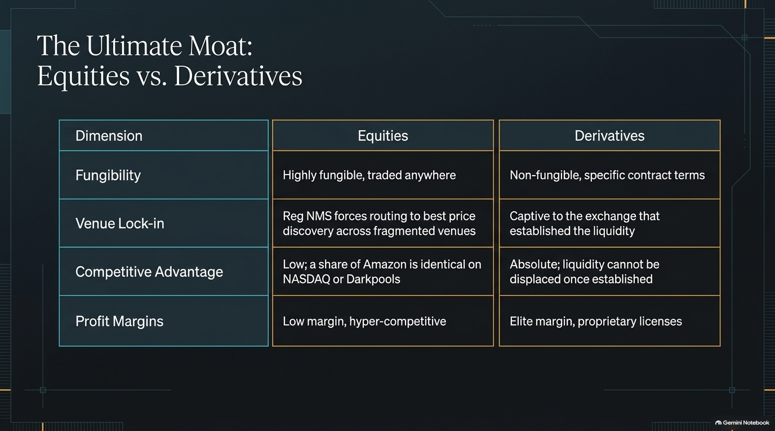
Notes:
Core Topic: Comparing Fungibility, Venue Lock-in, Competitive Advantage, and Margins
Not all exchange revenue is created equal. To understand where the true economic moat lies, we must contrast Equities versus Derivatives:
Equities: Highly fungible and traded across fragmented venues due to regulatory frameworks like Reg NMS. A share of Amazon is identical whether bought on NASDAQ, NYSE, or a dark pool. Consequently, equities are low margin and hyper-competitive.
Derivatives: Non-fungible contracts with specific terms. Because liquidity is captive to the specific exchange that established the product (e.g., Eurodollar futures or specific index options), the competitive advantage is absolute. Once liquidity settles in one venue, it cannot be displaced, yielding elite profit margins.

Slide 6
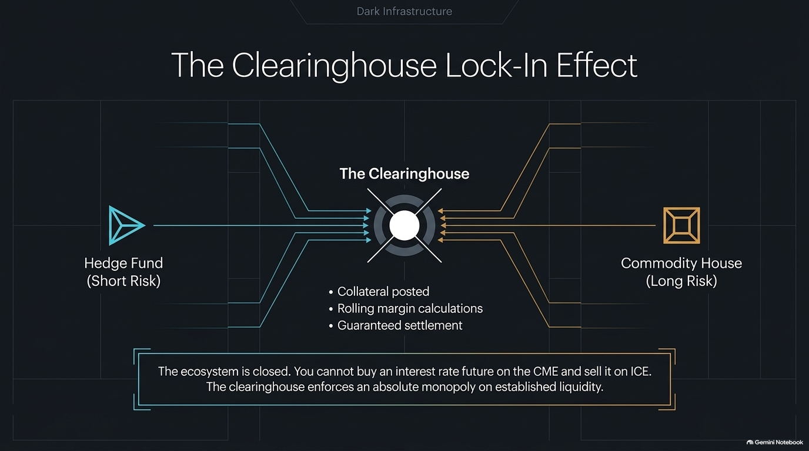
Notes:
Core Topic: Counterparty Risk, Collateral, and Absolute Ecosystem Monopolies
The structural anchor of this derivative moat is The Clearinghouse. Look at how risk flows through the center of this architecture:
When a hedge fund takes short risk and a commodity house takes long risk, neither trades directly with the other. Both sides post collateral, submit to rolling margin calculations, and rely on the clearinghouse for guaranteed settlement.
The Closed Ecosystem: You cannot buy an interest rate future on the CME and clear it on ICE. The clearinghouse enforces an absolute monopoly on established liquidity, creating insurmountable switching costs for institutional market participants.

Slide 7
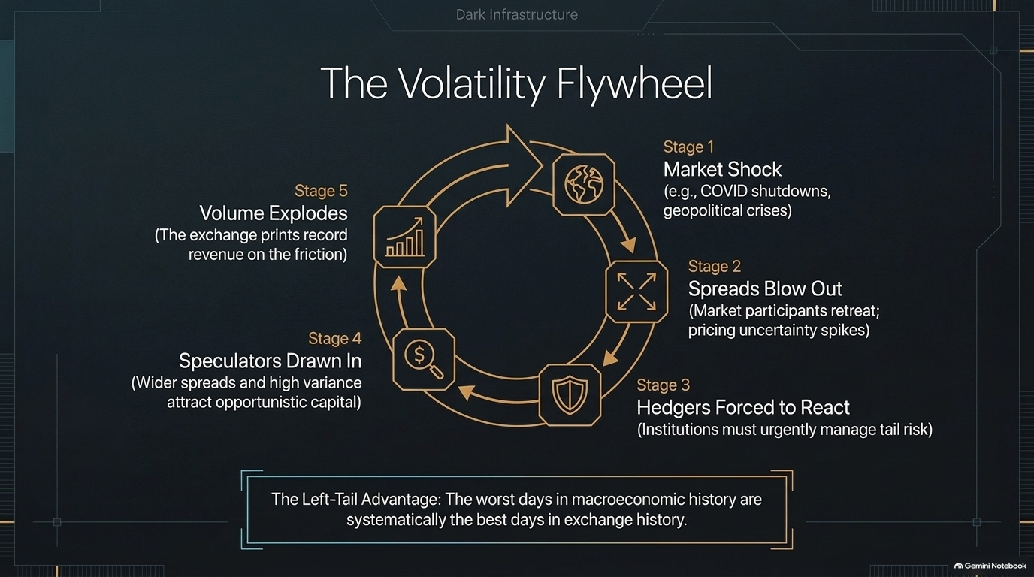
Notes:
Core Topic: The Five Stages of Market Shock and Left-Tail Advantage
One of the most counterintuitive aspects of exchange economics is how they profit from chaos. Look at The Volatility Flywheel on this slide:
Stage 1 (Market Shock): COVID shutdowns, inflation surprises, or geopolitical crises hit the global economy.
Stage 2 (Spreads Blow Out): Market participants retreat as pricing uncertainty spikes.
Stage 3 (Hedgers Forced to React): Institutions must urgently manage tail risk and rebalance portfolios.
Stage 4 (Speculators Drawn In): Wider spreads and high variance attract opportunistic trading capital.
Stage 5 (Volume Explodes): The exchange prints record revenue on the friction of the panic.
The Left-Tail Advantage: The worst days in macroeconomic history are systematically the best days in exchange financial history.

Slide 8
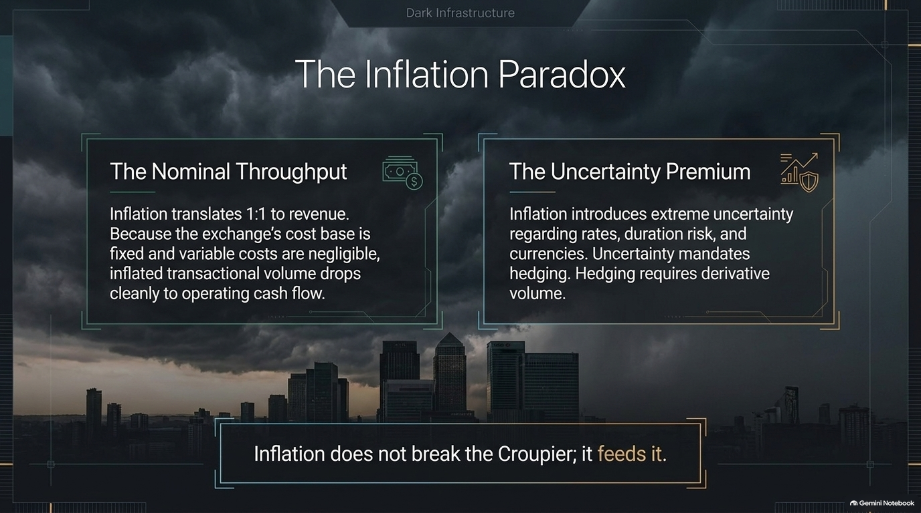
Notes:
Core Topic: Nominal Throughput and the Uncertainty Premium in Inflationary Regimes
In an inflationary environment where traditional businesses struggle with margin compression and rising labor costs, exchanges experience The Inflation Paradox:
The Nominal Throughput: Inflation translates 1-to-1 into nominal transaction values and exchange revenue. Because the exchange's cost base is fixed, inflated transactional volume drops cleanly to operating cash flow.
The Uncertainty Premium: Inflation introduces extreme uncertainty regarding interest rates, duration risk, and currency stability. Uncertainty mandates hedging, and hedging directly generates massive derivative volume.
Takeaway: Inflation does not break the croupier; it feeds it.

Slide 9
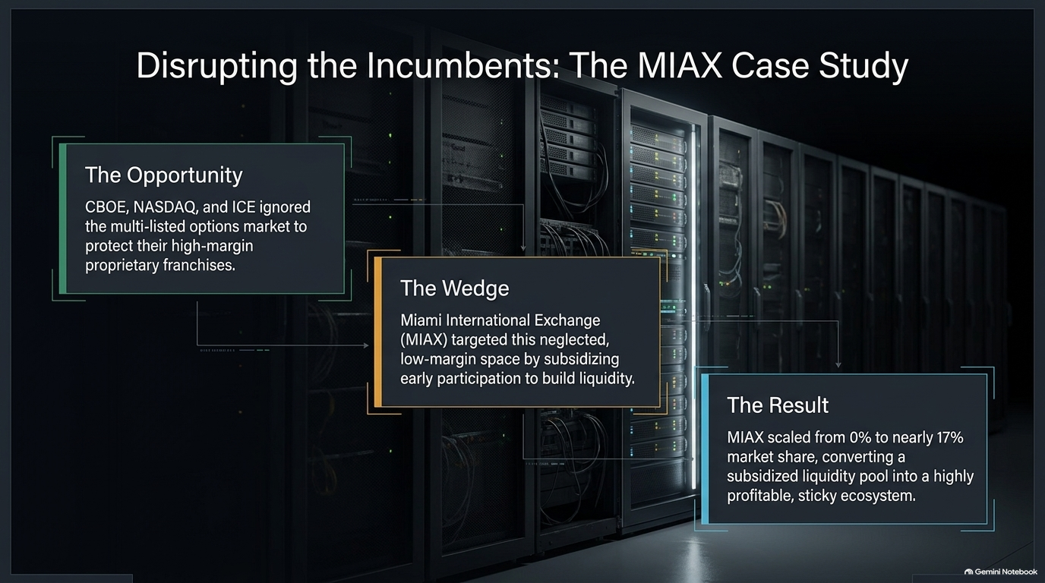
Notes:
Core Topic: Miami International Exchange (MIAX), Low-Margin Wedges, and Scaling to 17% Market Share
Can incumbent exchanges ever be disrupted? Let's examine The MIAX Case Study (Miami International Exchange):
The Opportunity: Major players like CBOE, NASDAQ, and ICE ignored the multi-listed options market to protect their high-margin proprietary franchises.
The Wedge: MIAX targeted this neglected, low-margin space by subsidizing early trading participation to build initial liquidity.
The Result: MIAX successfully scaled from 0% to nearly 17% market share, converting a subsidized liquidity pool into a highly profitable, sticky ecosystem. This proves that strategic wedges can succeed where execution precision matches architectural discipline.

Slide 10
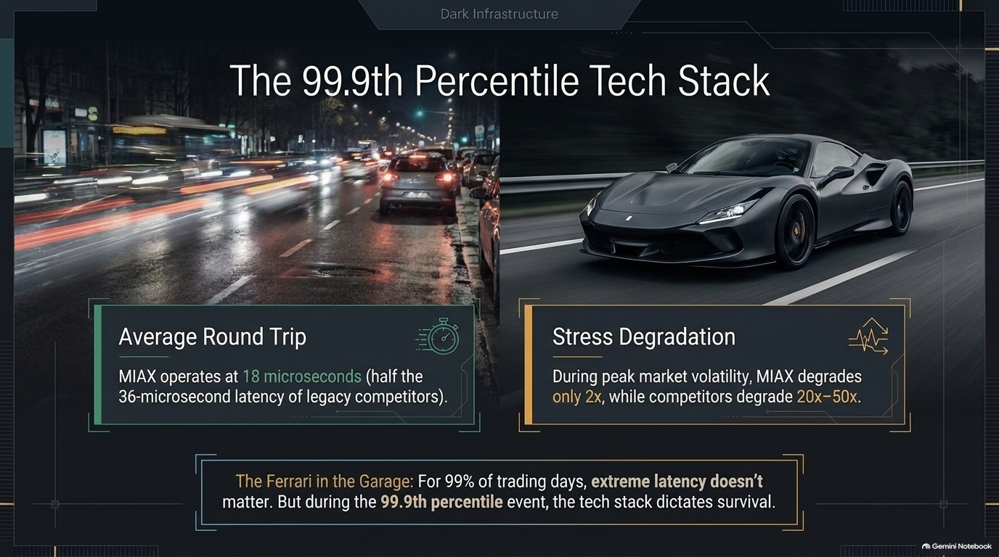
Notes:
Core Topic: Microsecond Latency, Stress Degradation, and Extreme Event Survival
In exchange architecture, technology performance is measured at the extremes. Look at The 99.9th Percentile Tech Stack on this slide:
Average Round Trip: MIAX operates at 18 microseconds—half the 36-microsecond latency of legacy competitors.
Stress Degradation: During peak market volatility (when traffic floods the system), MIAX's infrastructure degrades by only 2x, while legacy competitors degrade 20x to 50x.
The Ferrari in the Garage: For 99% of trading days, extreme latency doesn't matter. But during a 99.9th percentile black swan event, superior tech stack engineering dictates institutional survival.

Slide 11
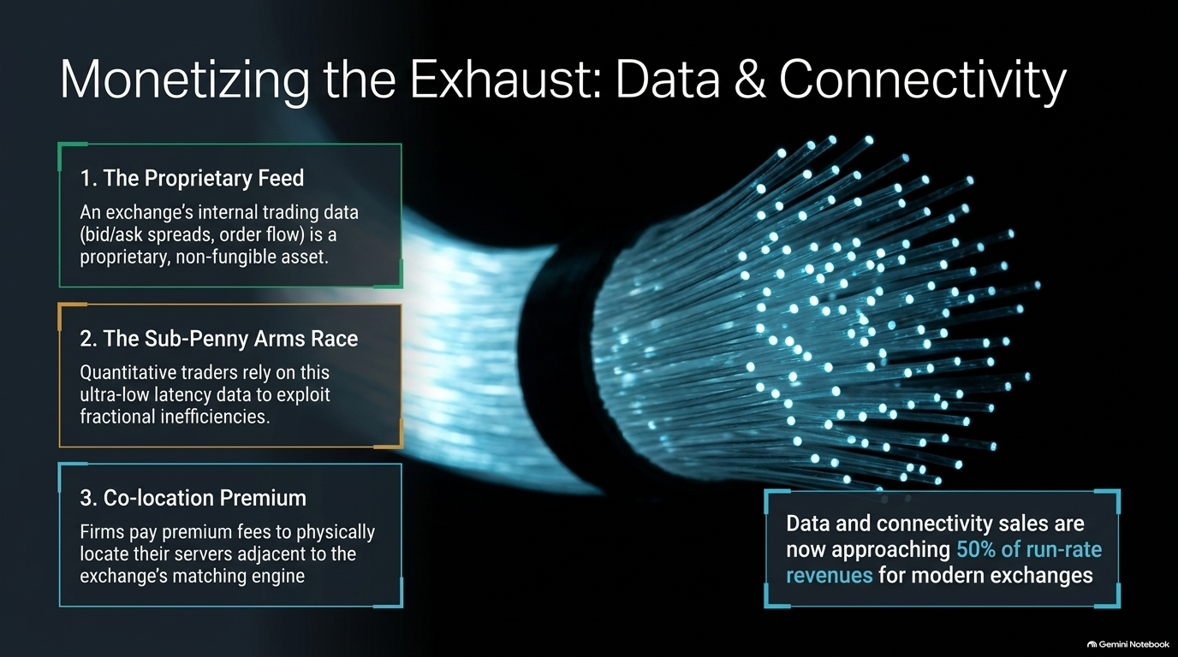
Notes:
Core Topic: Proprietary Feeds, the Sub-Penny Arms Race, and Co-location Premiums
Transaction fees are only part of the story. Modern exchanges have mastered Monetizing the Exhaust: Data & Connectivity:
The Proprietary Feed: An exchange's internal trading data (bid/ask spreads and order flow) is a proprietary, non-fungible asset.
The Sub-Penny Arms Race: Quantitative trading firms rely on ultra-low latency data feeds to exploit fractional market inefficiencies.
Co-location Premium: High-frequency trading firms pay premium fees to physically locate their server racks adjacent to the exchange's matching engine.
Data and connectivity sales are now approaching 50% of run-rate revenues for modern exchanges, transforming them into high-margin data analytics enterprises.

Slide 12
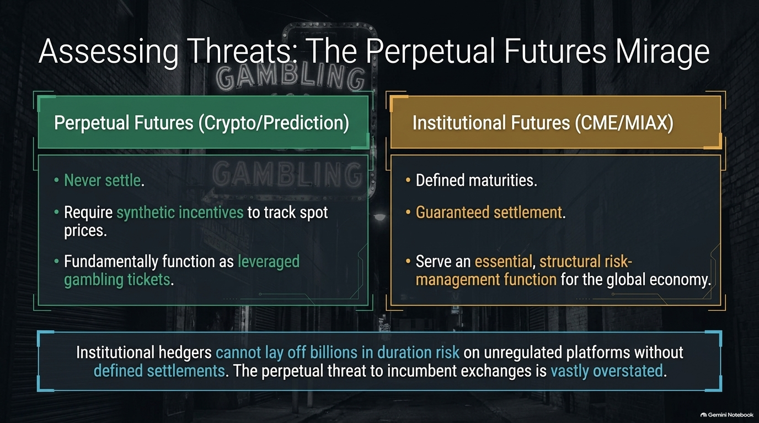
Notes:
Core Topic: Crypto Perpetual Futures vs. Regulated Institutional Futures (CME/MIAX)
A common bear case against traditional exchanges is the rise of decentralized or crypto-native perpetual futures. Let's do a reality check on The Perpetual Futures Mirage:
Perpetual Futures (Crypto/Prediction): Never settle, require synthetic incentives to track spot prices, and fundamentally function as leveraged gambling tickets.
Institutional Futures (CME/MIAX): Defined maturities, guaranteed settlement, and robust collateral backing. They serve an essential, structural risk-management function for the global economy.
Institutional hedgers cannot safely lay off billions of dollars in duration risk on unregulated platforms without defined settlements. The perpetual threat to incumbent exchanges is vastly overstated.

Slide 13
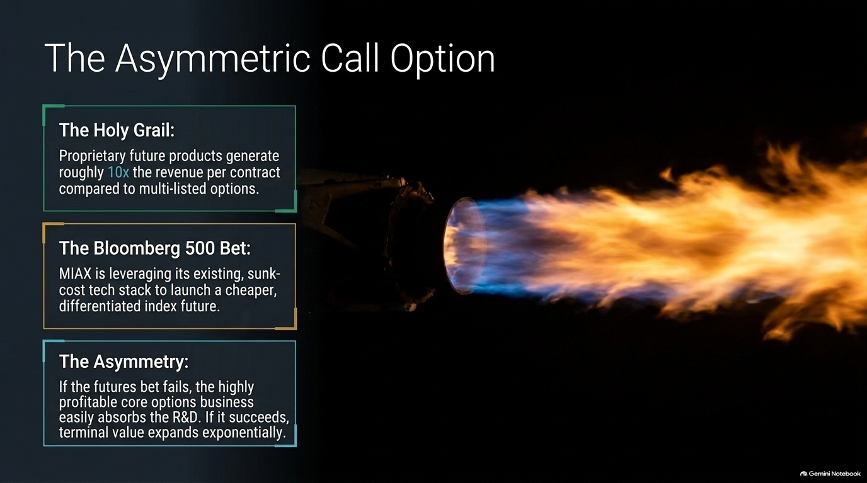
Notes:
Core Topic: Proprietary Index Products, the Bloomberg 500 Bet, and Downside Protection
Beyond core trading, successful exchanges continually plant seeds for exponential upside. Look at The Asymmetric Call Option on this slide:
The Holy Grail: Proprietary future products generate roughly 10x the revenue per contract compared to standard multi-listed options.
The Bloomberg 500 Bet: MIAX is leveraging its existing, sunk-cost tech stack to launch cheaper, highly differentiated proprietary index futures.
The Asymmetry: If the new futures bet fails, the highly profitable core options business easily absorbs the R&D burn. If it succeeds, terminal enterprise value expands exponentially.

Slide 14
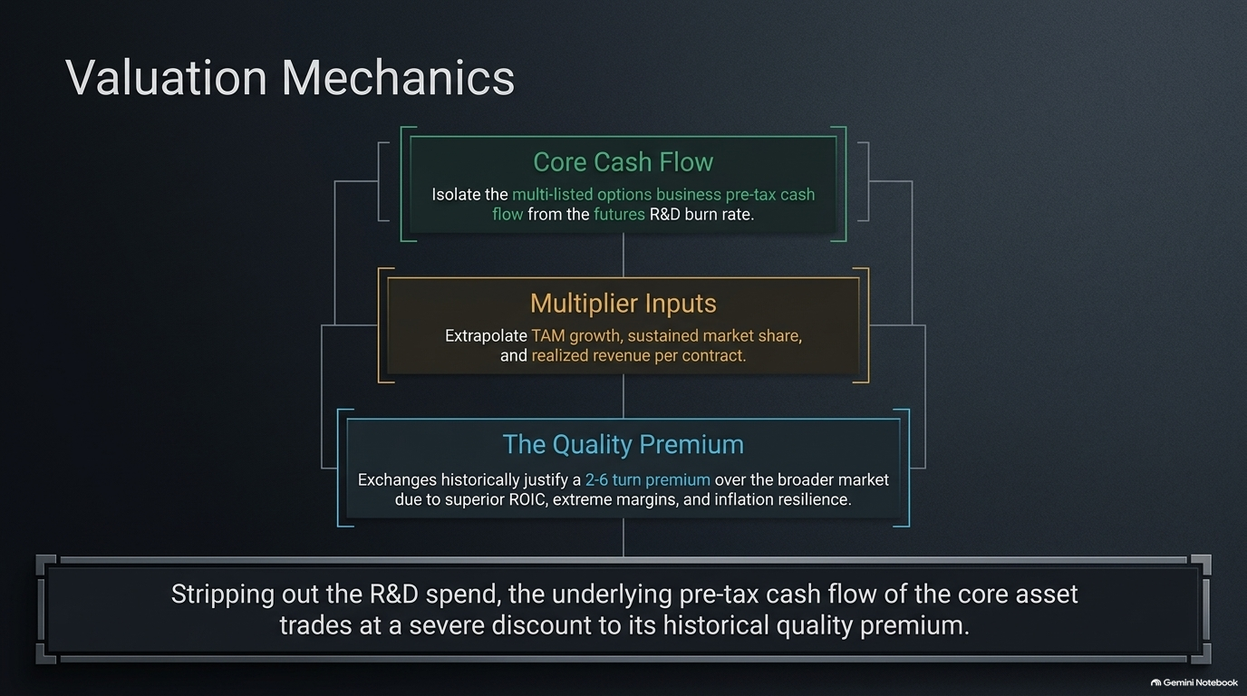
Notes:
Core Topic: Isolating Core Cash Flows, Multiplier Inputs, and the Quality Premium
How should investors value these exchange assets? Let's examine Valuation Mechanics through the Horizon Kinetics lens:
Core Cash Flow: Isolate the multi-listed options business pre-tax cash flow, stripping out exploratory futures R&D burn rates.
Multiplier Inputs: Evaluate total addressable market (TAM) growth, sustained market share, and realized revenue per contract.
The Quality Premium: Historically, high-quality exchanges justify a 2x to 6x valuation premium over the broader market due to superior return on invested capital (ROIC), operating margins, and inflation resilience.
When you strip out R&D spend, the underlying cash flow of the core asset often trades at a severe discount to its historical quality premium.

Slide 15
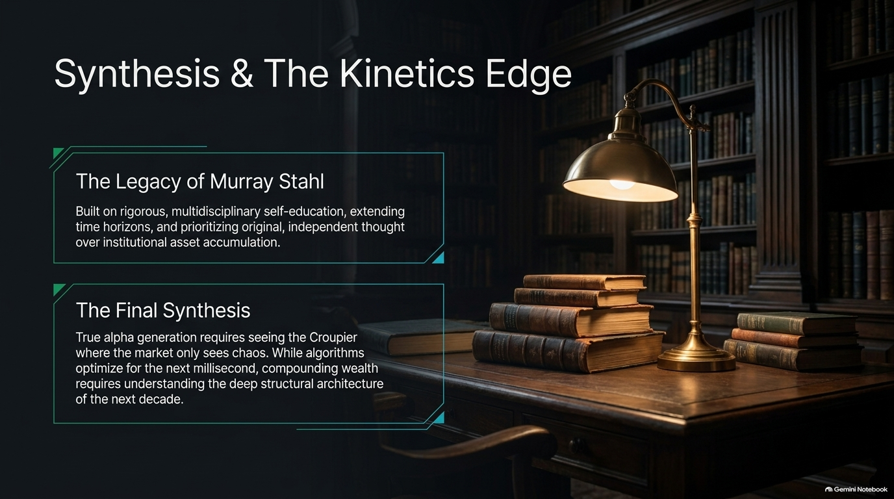
Notes:
Core Topic: Murray Stahl's Legacy, Multidisciplinary Thinking, and Long Time Horizons
To synthesize our entire framework, we look to The Legacy of Murray Stahl and Horizon Kinetics:
Built on rigorous, multidisciplinary self-education, extending time horizons, and prioritizing original, independent thought over institutional asset accumulation.
The Final Synthesis: True alpha generation requires seeing the croupier where the market only sees short-term operational chaos. While algorithmic traders optimize for the next millisecond, compounding long-term wealth requires understanding the deep structural architecture of the next decade.

Slide 16
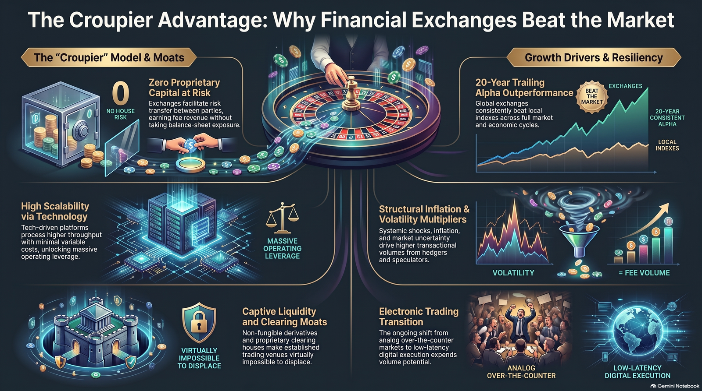
Notes:
Core Topic: Comprehensive Recap of the Exchange Business Model Moats
To wrap up, this final summary slide captures the essence of our journey: zero proprietary risk, massive operating leverage, captive clearinghouse liquidity, and inflation resilience.
Financial exchanges are not just trading venues; they are irreplaceable toll booths at the center of global capitalism. Thank you for your time today.

